Slide 1

What is wi-fi

Slide 2


Wi-Fi is the name of a wireless networking technology that uses radio waves to provide high-speed network and Internet connections.
The term Wi-Fi was created in 1999 by Wi-Fi Alliance which is an open, non-profit organization responsible of Wi-Fi standards development, marketing, Wi-Fi certification,...etc
Wi-Fi is a family of wireless network protocol, based on the IEEE(institute of Electrical and Electronics Engineers) 802.11 family of standards.

Slide 3
How does wi-fi work

Slide 4
Wi-Fi works off of the same principal as other wireless devices - it uses radio frequencies to send signals between devices. Wi-Fi transmits and receives data in the Gigahertz range.
Your laptop/tablet/etc. uses a wireless adapter to translate data into a radio signal and transmit that signal using an antenna and that signal are received by your wireless router.
That wireless router then converts the radio waves back into data and then sends that data to the Internet using a physical connection.
To get data from the Internet to your laptop/tablet/etc. , just reverse the process !!

Slide 5
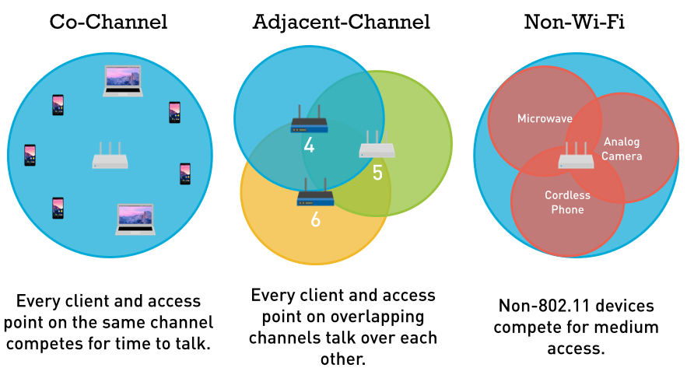
Wi-fi channel
Our router use two WiFi frequency bands for signal: 2.4 GHz or 5 GHz
Wi-Fi frequency signal can be interference. So we need to choose the right channel to improve wifi performance.

Slide 6
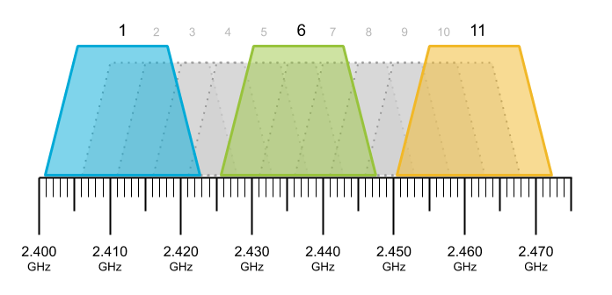
Wifi channel
Each channel on the 2.4 GHz spectrum is 20 MHz wide. operate between the frequencies of 2400 and 2500MHz. These 100MHz are separated into 14 channels.

Slide 7
Future of wi-fi

Slide 8

Wi-fi 7(802.11be)
The Wi-Fi 6 has just barely arrived yet. But there has been planned for Wi-Fi which is likely in 2024 according to Qualcomm.
This Wi-Fi standard will have 6GHz band which will be excellent for offering high-speed Wi-Fi
Support multi-band and multi-channel.
It’s expect to handle a numerous of device simultaneously

